Slide 1


Welcome
to
our class

Slide 2
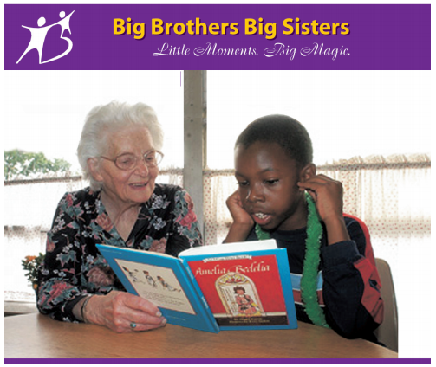
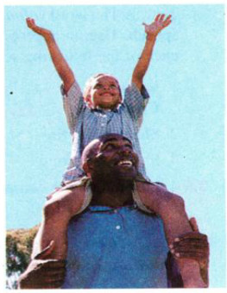
Look at the pictures and answer the questions.
1. What are they doing?
2. What are the relations between them?

Slide 3
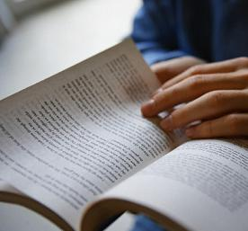
unit 4
Grade : 11
Period : 21st unit:4
VOLUNTEER WORK
Part A: Reading

Slide 4

I-Before reading
1. Read the following saying and explain what it means
“ If you give me a fish,
I will eat today.
If you teach me to fish,
I will eat my whole life long.”
This saying means that we should teach a person how to earn money or produce food rather than give them money or food. In other words, we had better teach them a job than give them money.

Slide 5

Each nation has many people who voluntarily take care of others. For example, many high school and college students in the United States often spend many hours as volunteers in hospitals, orphanages or homes for the aged. They read books to the people in these places. Sometimes the students just visit them, play games with them or listen to their problems.
Other young volunteers work in the homes of sick or old people. They clean up their houses, do their shopping or mow their lawns. For boys who no longer have fathers, there is a voluntary organization called Big Brothers. College students take these boys to baseball games and help them to get to know things that boys usually learn from their fathers.
Some high school students take part in helping disadvantaged or handicapped children. They give care and comfort to them and help them to overcome their difficulties. Young college and university students participate in helping the people who have suffered badly in wars or natural disasters. During summer vacations, they volunteer to work in remote or mountainous areas to provide education for children.
Each city has a number of clubs where boys and girls can go to play games. Some of these clubs organise short trips to the mountains, beaches or other places of interest. Most of these clubs use a lot of high school and college students as volunteers because they are young enough to understand the problems of younger boys and girls.
Volunteers believe that some of the happiest people in the world are those who help to bring happiness to others.

Slide 6

PRE READING:
1. Vocabulary:
- volunteer (n) / ,vɔlən'tiə/
người tình nguyện, người xung phong
- (to) volunteer (v):
tình nguyện, xung phong làm
- voluntary (adj) /’vᴅləntri/
tình nguyện, tự nguyện
- voluntarily (adv) /’vᴅləntrəli/
một cách tình nguyện
- orphanage (n) /'ɔ:fənidʒ/:
trại mồ côi
disadvantaged children (n):
/,disəd’va:ntidʒ/
trẻ em bị thiệt thòi
handicapped children (n)
/'hændikæpt/
trẻ em khuyết tật
- Overcome (v):
vượt qua
- (to) participate in = (to) take part in:
tham gia vào

Slide 7
II: WHILE READING
Task 1: The word volunteer appears in the passage in different parts of speech. Use an appropriate form of the word volunteer to complete each of the following sentences.
VOLUNTARY
When she retired, she did a lot of……………….…….service for the Red Cross.
She was not fired. She left the company……………………..
She needs some………………….……..to clean up the kitchen.
Last month the company……………….…….to donate fifty
trucks to help flooded areas.
(adj)  service (n)
VOLUNTARILY
S V O
 (adv)
VOLUNTEERS
some  (n)
VOLUNTEERED
S (v)


Slide 8
Each nation has many people who voluntarily take care of others. For example, many high school and college students in the United States often spend many hours as volunteers in hospitals, orphanages or homes for the aged. They read books to the people in these places. Sometimes the students just visit them, play games with them or listen to their problems.
Other young volunteers work in the homes of sick or old people. They clean up their houses, do their shopping or mow their lawns. For boys who no longer have fathers, there is a voluntary organization called Big Brothers. College students take these boys to baseball games and help them to get to know things that boys usually learn from their fathers.
Some high school students take part in helping disadvantaged or handicapped children. They give care and comfort to them and help them to overcome their difficulties. Young college and university students participate in helping the people who have suffered badly in wars or natural disasters. During summer vacations, they volunteer to work in remote or mountainous areas to provide education for children.
Each city has a number of clubs where boys and girls can go to play games. Some of these clubs organise short trips to the mountains, beaches or other places of interest. Most of these clubs use a lot of high school and college students as volunteers because they are young enough to understand the problems of younger boys and girls.
Volunteers believe that some of the happiest people in the world are those who help to bring happiness to others.

Slide 9
Task 2. Choose the best answer from A, B, C or D for each of the following sentences:
Volunteers usually help those who are sick or old in their homes by……..
A. mowing the lawns, doing shopping and cleaning up their houses.
B. cooking, sewing or washing their clothes.
C. telling them stories, and singing and dancing for them.
D. taking them to baseball games.
2. Big Brothers is….
A. the name of a club
B. a home for children
C. the name of a film
D. an organization for boys who no longer have fathers.
A
D

Slide 10
3. Most of the boys’ and girls’ clubs use many high school and college students as volunteers because they………..
A. have a lot of free time.
B. can understand the problems of younger boys and girls.
C. know how to do the work
D. are good at playing games
4. Volunteers believe that…………………
A. in order to make others happy, they have to be unhappy.
B. the happiest people are those who make themselves happy.
C. the happiest people are those who are young and healthy
D. bringing happiness to others makes them the happiest people.
5. The best title for the passage is…………….
A. Taking care of others
B. Voluntary Work in the United States.
C. Volunteers: The Happiest People in the world.
D. Help Old and Sick people in the United States
B
D
B

Slide 11
Task 3: Answer the following questions.
What do high school and college students usually do as volunteers in hospitals, orphanages or homes for the aged?
→They read books to the people there, play games with them or listen to their problems. (p₁₋ L₇₋₁₀ )
2. How do volunteers help disadvantaged and handicapped children to overcome their difficulties?
→ They give care and comfort to them and help them to overcome their difficulties.(P₃ L_{2,3})
3. Where do students volunteer to work during summer vacations?
→ They volunteer to work in remote or mountainous areas.(P₃ L_{5,6,7})

Slide 12

III: POST READING:
GAP FILLING

Slide 13
college
remote
give care
comfort
volunteers
take part
hospital
high school
orphanages
mountainous
In United State many………... and …… .students often spend many hours as volunteer in............., …………….. or homes for ages.
Some high school students ................in helping disadvantages or handicapped children. They....................and.................to them. They provide education for children in.............and...................areas.
Most of the clubs in the cities use a lot of high school, college students as...............because they are young enough to understand the problems of younger boys and girls.

Slide 14

HOMEWORK
- Learn new words by heart.
- Write a short passage about the volunteer work which you have done.

Slide 15




Thank you for your attention!

